Slide 1
Plants and nutrients
March 5, 2019
Figures from textbooks unless otherwise noted

Slide 2
What essential elements do plants use?

Slide 3
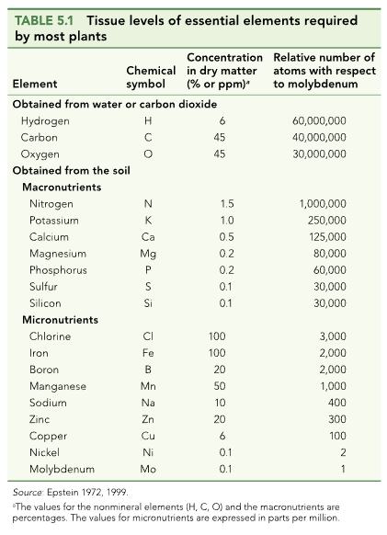

Slide 4
What do they use them for?

Slide 5
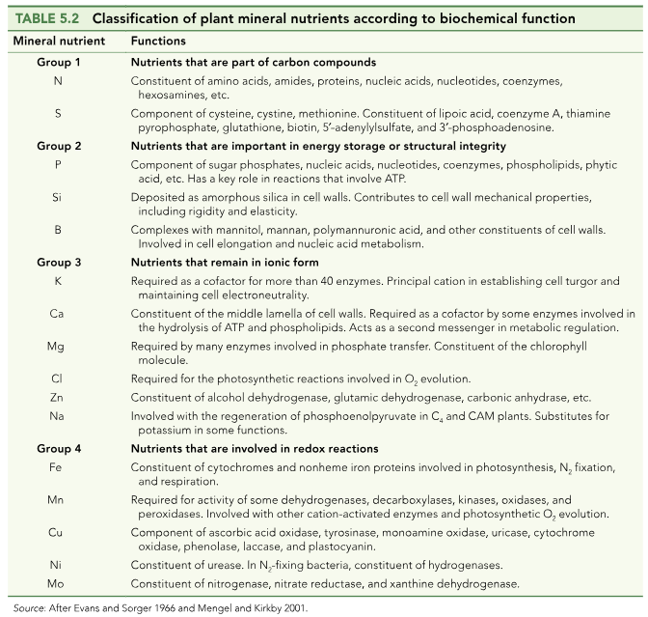

Slide 6
How do nutrients get into the soil?

Slide 7
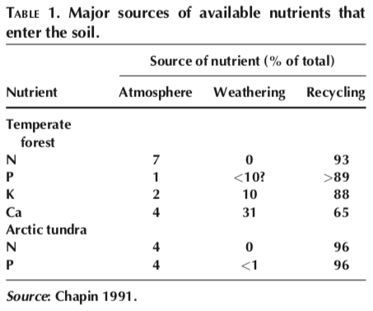

Slide 10
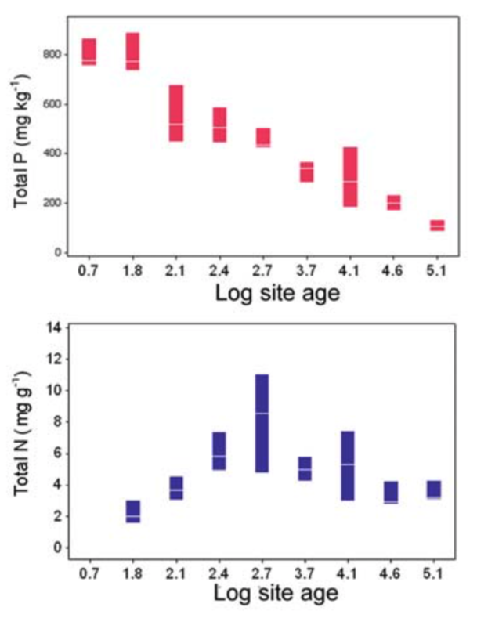
What could explain these trends?

Slide 11
Nutrition impacts: NPP

Slide 12
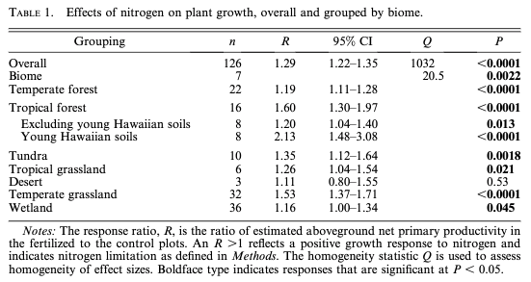
N addition increases NPP by 29% (Lebauer and Treseder, 2008)

Slide 13
N addition increases NPP by 29% (Lebauer and Treseder, 2008)
What could explain this effect?

Slide 14
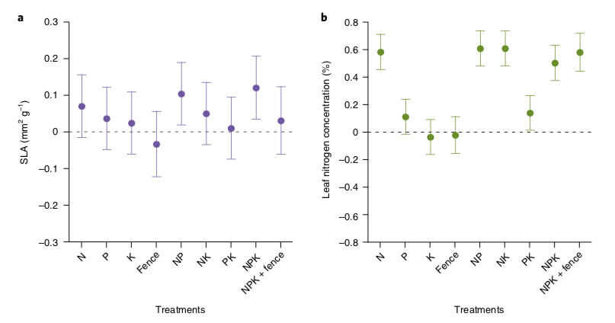
Leaves are basically the same shape, but get packed with more N
Firn et al. (2019)

Slide 15
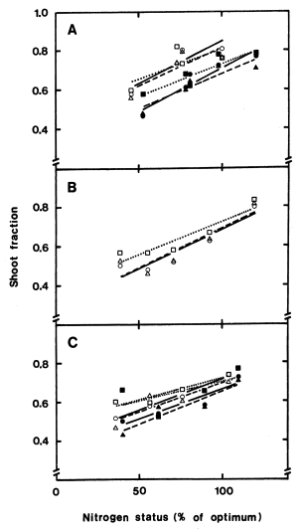
More leaves and shoots are produced at the expense of roots
Ingested et al. (1991)

Slide 16
Nutrition impacts: Diversity

Slide 17
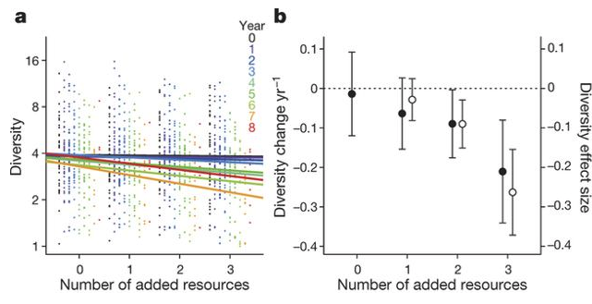
Why would adding nutrients reduce diversity?
Harpole et al. (2016)

Slide 18
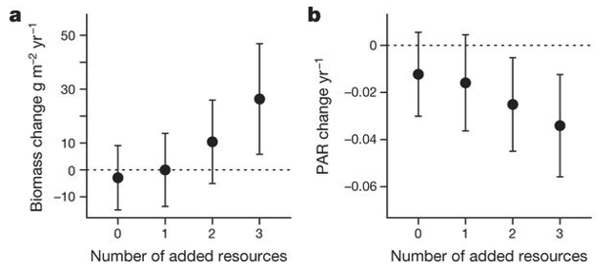
A shift in the importance of other resources!
Harpole et al. (2016)

Slide 19
Competition example: tallgrass prairie

Slide 20
Competition example: tallgrass prairie
Wildflowers
C3
Fast growing
Use a lot of resources (e.g., Nitrogen)
Grasses
C4
Slow growing
Efficient resource use

Slide 21
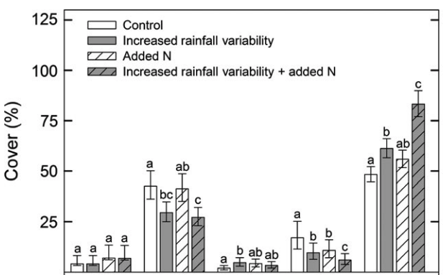
Competition example: tallgrass prairie
Grasses
Wildflowers
Smith et al. (2016)

Slide 22
Competition example: tallgrass prairie
Smith et al. (2016)

Slide 23
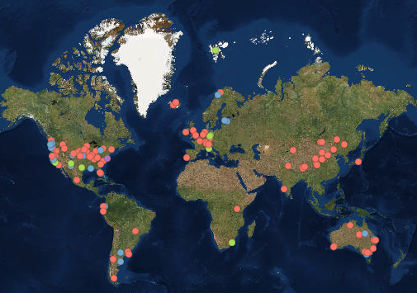
The Nutrient Network: idea for your deliverable?
>100 places all doing the same experiment!
Treatments:
N, P, and K additions
All combinations
With and without herbivores
Measurements
Biomass
Community composition
Light availability

Slide 24
The Nutrient Network: idea for your deliverable?
We have a site in Lubbock!
Contact Nick if you are interested in using the NutNet data (for our site or others)

